Slide 1
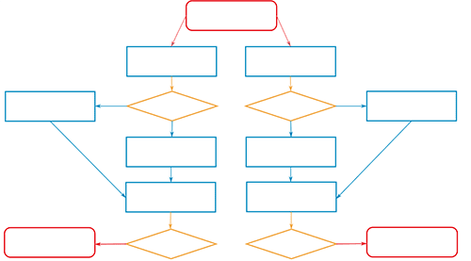
TITLE (SHOULD BE THE SAME AS THE ACCEPTED)
LOGO OF THE AUTHORS' AFFILIATION INSTITUTION
Last name1, N.¹, Last name2, N.¹, Last name3, N.² & Last name4, N.³
¹ Faculty, Department or Research Group, Name of the University or Institution, Address, City, Country
² Faculty, Department or Research Group, Name of the University or Institution, Address, City, Country
³ Faculty, Department or Research Group, Name of the University or Institution, Address, City, Country
Corresponding author:
REFERENCE CODE
INTRODUCTION
RESULTS
The introduction should be a single paragraph summarizing the problem, the main objective of the work, and the importance of having done it. The spelling, writing, and proper use of punctuation marks should be carefully checked. If acronyms are included, their meaning should be explained. The scientific name of the animal, plant, or microorganism species involved should be included. It may include the references, which should be referenced on the poster itself.
Similarly, it is recommended to present the most relevant results of the study through tables and graphs that are sufficiently understandable. Pay attention to the size of numbers and letters, especially in graphs. They should also be given a title.
MATERIAL AND METHODS
It is recommended to use tables, diagrams or other types of graphic schemes and minimize the use of text.
Figure 2. xxxxxxxxxx
Table 2. XXXXXX
Figure 1. xxxxxxxxxx
CONCLUSIONS
Do not repeat the results in this section. The most relevant findings of the study should be discussed, in direct relation to the stated objectives.
REFERENCES
Last name 1, N. & Last name 2, N. (year) Title of the article. Name of the journal, Volume (number), Page-Page. doi:
Last name 1, N. & Last name 2, N. (year) Title of the article. Name of the journal, Volume (number), Page-Page. doi:
ACKNOWLEDGEMENTS
People, projects, or institutions that collaborated with the study or provided funding.

